Slide 1
Hutchinson Elementary Principal’s Report
March 16, 2023
Presented by Ms. StJoy

Slide 2
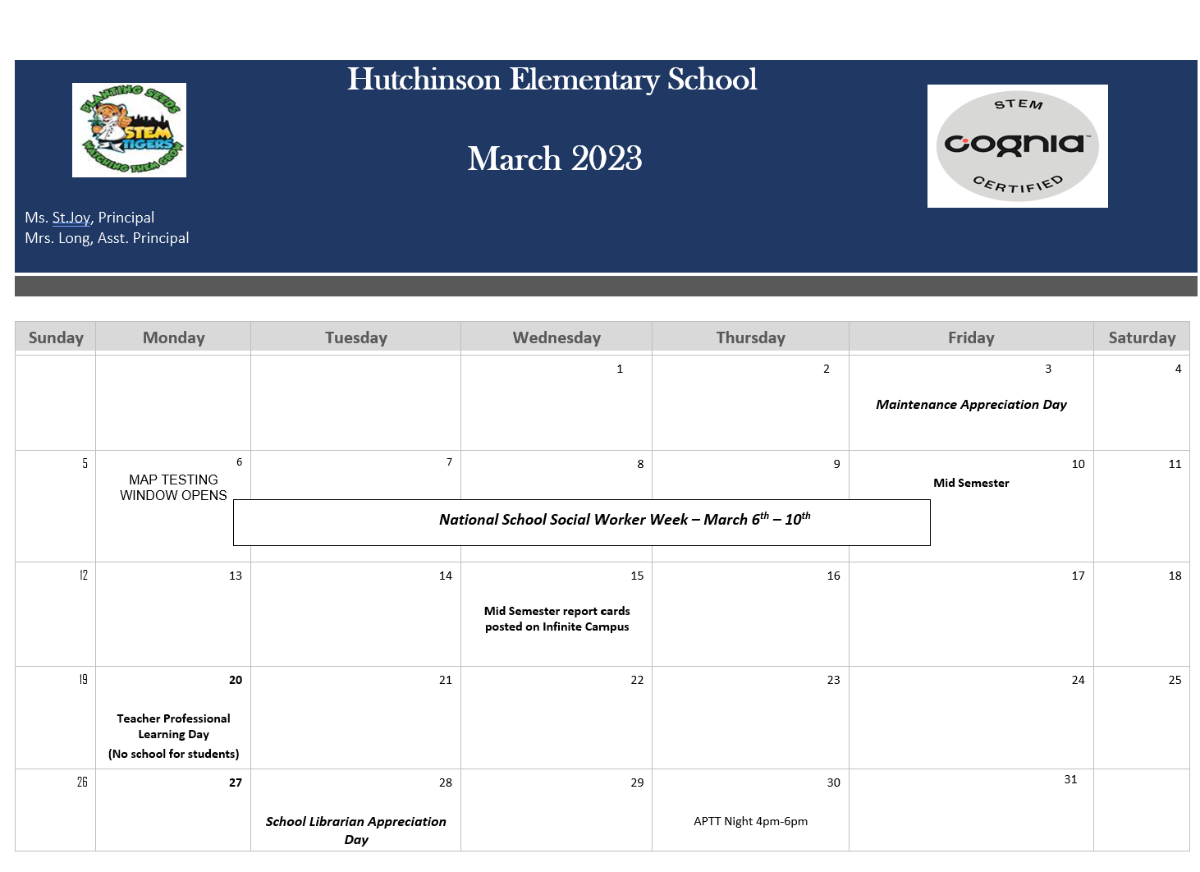
March 20th Teacher Planning (No school for students)
School Librarian Appreciation Day March 28th
Community Food Bank March 21st
Academic Parent Teacher Teams Night March 30th

Slide 3

65 Parents attended in the Fall
58 Parents attend in the Winter
Next meeting is March 30th

Slide 4
Upcoming
Spring Break April 3-7
Teacher Appreciation Week May 1st
Georgia Milestones testing May 1st- 12th
Next Meeting TBD (April or May)

